Slide 1
Chapter 18
Sustainability & Environmental Management Accounting (EMA)

Slide 2
Objectives
After studying this topic you should be able to:
Identify the key features of environmental management accounting
Understand how businesses achieve sustainability
Discuss the key benefits of EMA
Understand the different methods for EMA reporting.

Slide 3
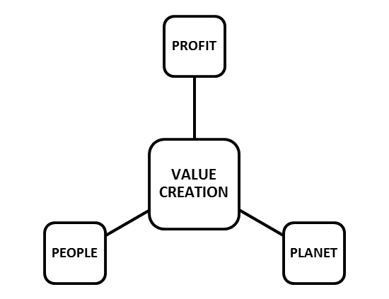
The Triple Bottom Line

Slide 4
Managing a Sustainable Business
Stakeholder Engagement
Environmental Reporting Systems
Lifecycle Analysis

Slide 5
Managing a Sustainable Hospitality, tourism or events business (1)
The use of natural resources and energy saving materials in fitting out and constructing new hotels, event venues and tourist attractions
Landscaping using native plants with low impact irrigation, restoring disturbed natural habitats
Utilising resources (e.g. food, materials, labour) from the immediate community and develop community resources

Slide 6
Managing a Sustainable Hospitality, tourism or events business (2)
Efficient utilisation of energy through lighting/heating and alternative sources of power such as solar or wind
Use of low impact products in cleaning and laundry and laundry reduction through guest education
Development of education and training programmes within the local community

Slide 7
EMA Reporting
EMA’s specific benefits and uses are sometimes linked to three key areas (IFAC 2005):
Compliance – This relates to where there are specific legal requirements, or ‘self-imposed’ environmental policies. EMA aids in meeting to requirement in a cost effective manner.
Eco–efficiency – Focuses on cost reductions through the more efficient use of resources, such as, electricity, gas, water and raw materials, this reduces costs, but also has an environmental impact by using less resources.
Strategic positioning – This focuses on the organisation’s long term strategy and competitiveness through its use of environmentally sensitive strategic policies and commitments.

Slide 8
EMA Reporting
Involves 2 types of EMA information to aid management decision making:
Monetary – financial impacts of environmental policy, costs, revenues, investments and liabilities created in an environmental context
Physical – physical measurement of elements such as CO2 emissions, energy consumption, material waste

Slide 9
Environmental Costs
ENVIRONMENTAL COSTS
ENVIRONMENTAL PREVENTION COSTS
ENVIRONMENTAL DETECTION COSTS
ENVIRONMENTAL INTERNAL FAILURE COSTS
ENVIRONMENTAL EXTERNAL FAILURE COSTS

Slide 10
Categories for Environmental Costs
Environmental Prevention Costs – These are the costs incurred in order to safeguard the environment and will include designing and monitoring processes to reduce waste, staff training, meeting required standards.
Environmental Detection Costs – These are the costs incurred in ensuring the organisation complies with legislation, regulations and voluntary standards and will include testing and inspection of processes and waste.
Environmental Internal Failure Costs – These are costs incurred following the production of waste or contaminants which have not been released into the environment and will include recycling scrap and disposing of toxic chemicals.
Environmental External Failure Costs – These are costs incurred following the production of waste or contaminants which have been released into the environment and will include cleaning up contaminated areas and compensation payments.

Slide 11
Example reducing towel usage

Slide 12
Example reducing towel usage

Slide 13
Categories for Environmental Costs
Environmangement Management Accounting
Monetry EMA (MEMA)
Past Oreiented Tools
Future Orientated Tools
Physical EMA
(PEMA)
Past Orientated Tools
Future Orientated Tools

Slide 14
Categories for Environmental Costs
MEMA – past orientated examples include reporting environmental spending and external disclosure of environmental related items in monetary value’
MEMA – future orientated examples include the budgeting for environmental expenditure, longer term capital investment appraisal (CIA), calculating the costs or financial savings of environmental projects.
PEMA – past orientated examples could include records of past material, energy and water usage in physical quantities, benchmarking and evaluating environmental performance against environmental budgets and benchmark data. Such data may also be reported: externally; directly to stakeholders; or perhaps government agencies if required.
PEMA – future orientated examples include budgeting and investment appraisal, but in physical, not monetary terms as in MEMA. The setting of physical quantity targets of resource usage, or CO₂ emission targets for example. This could be amending internal processes and procedures of production and service to ones that are more environmentally friendly; this could include environmental requirements stipulated to suppliers to the organisation.

Slide 15
EMA Techniques
Input/Output Analysis
Flow Cost Accounting
Environmental Activity Based Costing
Lifecycle Costing

Slide 16
Flow of Materials, Energy & Water
INPUTS
Raw materials
Water
BUSINESS ACTIVITY
Business activities in the production of changing inputs into products and services
OUTPUTS
Energy usage
Water pollution
Energy
Water usage
Waste products
CO₂ emissions

Slide 17
Environmental Management Accounting Guidelines
A number of EMA guidelines exist:
United Nations
The International Federation of Accountants (IFAC)
The UK Government
The Princes Sustainability Project
British Standard, BS8901: Sustainable Event Management System

Slide 18
Summary
Triple bottom line (people, planet and profits) is the focus of the need for a sustainability accounting system.
Managing a sustainable business requires organisation management to manage its resources in a sustainable way, environmental accounting aids this.
Environmental Management Accounting (EMA) provides a detailed internal reporting system concerning performance against environmental targets.
EMA benefits include compliance, eco-efficiency and strategic positioning.
EMA can be reported in monetary terms and physical terms and be used to record past events, or in planning for the future.
Environmental guidelines can be used to aid organisations in developing their own EMA system.

